Slide 1
Sexual Harassment of Women At Workplace (Prevention, Prohibition and Redressal) Act, 2013
Presentation By
Ms. Khushbu Prasad
.

Slide 2
Introduction
Sexual harassment is an act of power, and a public and collective violation that is often trivialised by labelling it an interpersonal transgression. It is therefore a violation of gender equality also, of the right to a safe education and work environment for all. Sexual harassment not only affects a few individuals but reinforces gender based discrimination for everyone.

Slide 3
Vishakha v State of Rajasthan
According to the guidelines given under this judgement, sexual harassment results in violation of the -
Fundamental rights to equality under Article 14 and 15 of the Constitution of India
Right to life and live with dignity under Article 21 of the Constitution of India
Right to participate any profession or to carry on any occupation, trade or business which includes right to a safe environment free from sexual harassment

Slide 4
Vishaka Guidelines
Vishaka v. State of Rajasthan
Sexual Harassment of Women at Workplace (Prevention, Prohibition and Redressal) Act, 2013
University Grants Commission (Prevention, Prohibition and Redressal of sexual harassment of women employees and students in higher educational institutions) Regulation, 2015.

Slide 5
Sexual Harassment means …
An unwanted conduct with sexual undertone
If it occurs or which persistent and which demeans, humiliates or creates a hostile and intimidating environment
Or is calculated to induce submission by actual or threatened adverse consequences
And includes any one or more or all of the following unwelcome acts or behaviour
(whether directly or by implication)

Slide 6
What is Sexual Harassment
S. 2 (n) “sexual harassment” includes any one or more of the following unwelcome acts or behavior (whether directly or by implication) namely:—
(i) physical contact and advances; or
(ii) a demand or request for sexual favours; or
(iii) making sexually coloured remarks; or
(iv) showing pornography; or
(v) any other unwelcome physical, verbal or non-verbal conduct of sexual nature;

Slide 7
Sexual Harassment 2 forms-
"Quid Pro Quo" literally means "this for that". Applying this to sexual harassment, it means seeking sexual favours or advances in exchange for work benefits such as promises of promotion, higher pay, academic advancements etc
"Hostile work environment" is a less clear yet more pervasive form of sexual harassment. It commonly involves conditions of work or behaviour towards a female worker, which make it unbearable for her to be there.

Slide 8
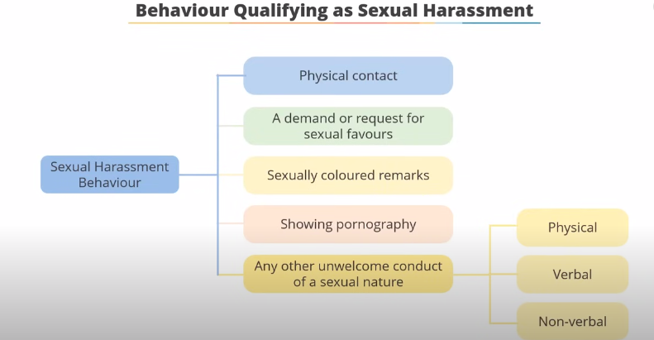

Slide 9

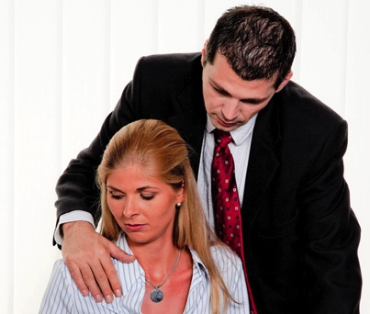
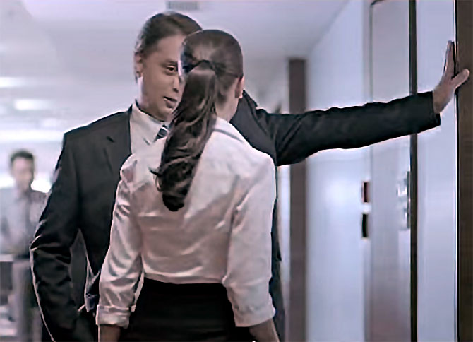


Physical Touch
Creating Hurdles
Any unwelcome
act

Slide 10
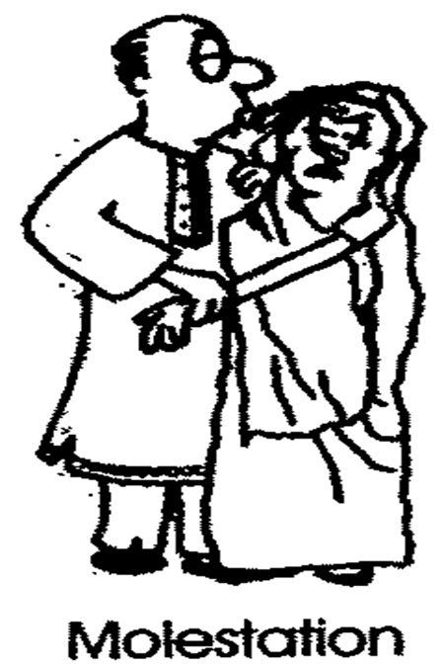
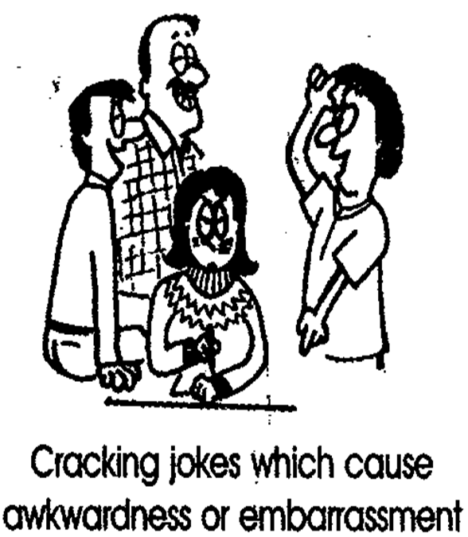
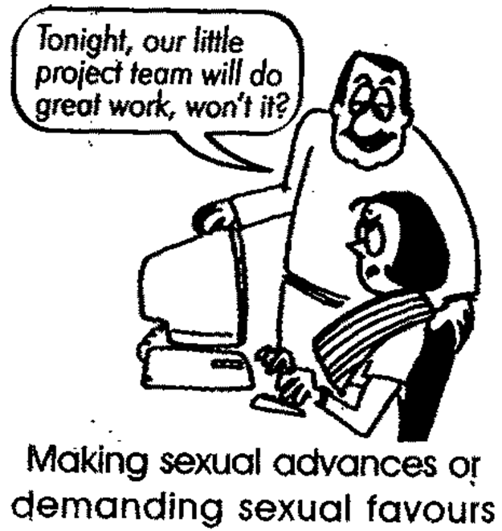

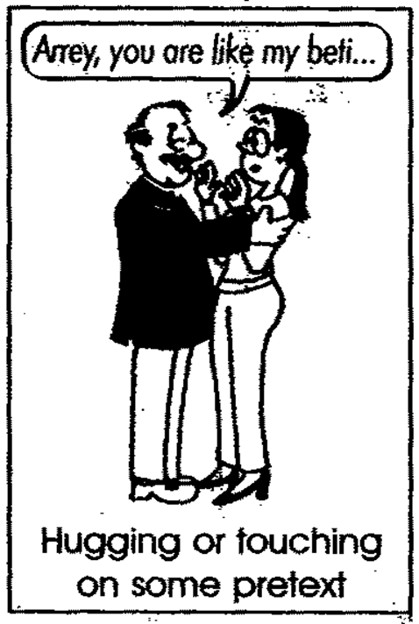

Sexual Harassment
Any unwelcome physical, verbal or non verbal conduct of sexual nature
Demand or request for sexual favours
Making sexually coloured remarks
Physical contact and advances or
Showing pornography

Slide 11
Sexual harassment at workplace can take various forms. It can involve conduct such as:
Unwelcome touching, hugging or kissing staring or
Leering suggestive comments or jokes
Unwanted or persistent requests to go out
Intrusive questions about another person’s private life or body
Deliberately brushing up against someone
Insults or taunts of a sexual nature
Sexually explicit pictures, posters, screen savers, emails, twitters, SMS or instant messages
Accessing sexually explicit internet sites
Inappropriate advances on social networking sites
Behaviour which would also be an offence under the criminal law, such as physical assault indecent exposure sexual assault, stalking or obscene communications.

Slide 12
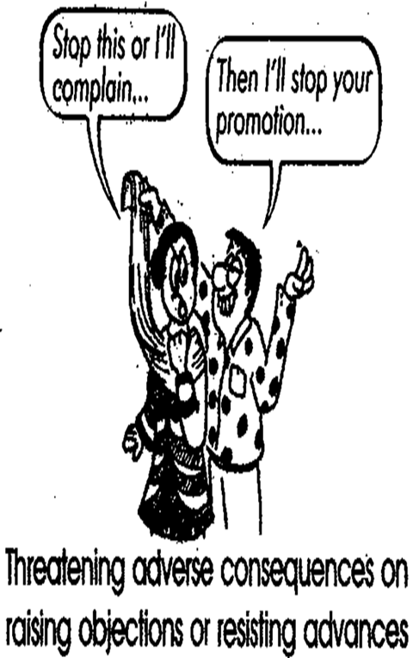
Any one (or more than one or all) of the following circumstances, if it occurs or is present in relation or connected with any behaviour that has explicit sexual undertones
Implied or explicit promise of preferential treatment as quid pro quo for sexual favours;
Implied or explicit threat of detrimental treatment in the conduct of work;
Implied or explicit threat about the present or future status of the person concerned;
Creating an intimidating offensive or hostile learning environment
Humiliating treatment likely to affect the health, safety dignity or physical integrity of the person concerned

Slide 13
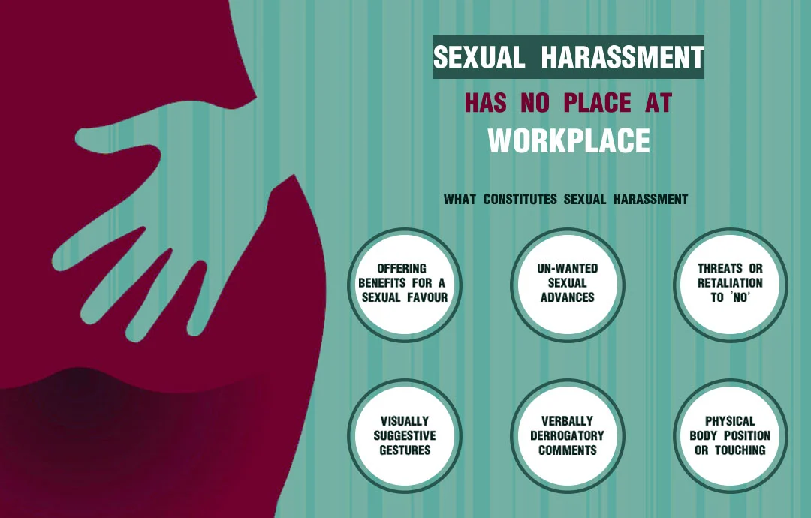

Slide 14
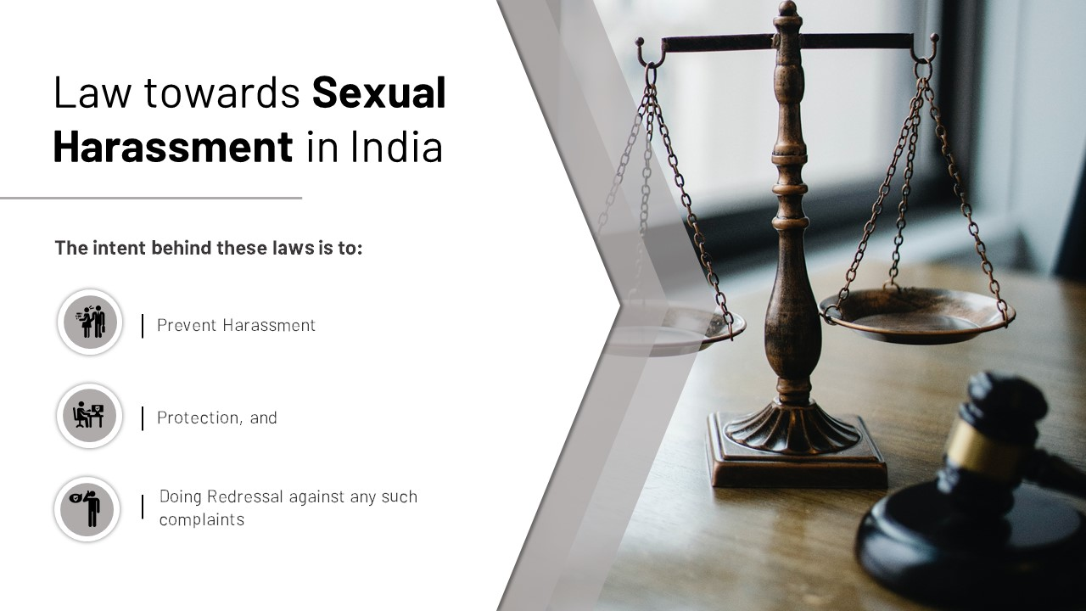

Slide 15
Who can file a complaint?
Aggrieved Women Herself, or
In case of physical incapacity –
  Her relative, Friend, Co worker,
  Officer of NCW or SCW
  Any person who has knowledge of incident with the written consent of complainant
In case of mental incapacity -
  Her relative, Friend,
  Special educator, Qualified psychiatrist or psychologist Guardian
  Or Authority under whose care she is receiving treatment or care Any person who has knowledge of incident jointly with any person mentioned above

Slide 16
Who is protected under this Law?
Aggrieved Women
In relation to work place, a woman of any age whether employed or not, who alleges to have been subjected to any act of sexual harassment by the respondent.
(Those who are under 18 years of age can lodge an FIR under the Protection of Children from Sexual Offences Act, 2012.)
Aggrieved Person
an aggrieved woman or a student (Gender Neutral) (Student – Regular or Distant Mode, in process of admission)
(University Grants Commission (Prevention, Prohibition and Redressal of Sexual Harassment of Women Employees and Students in Higher Institutions) Regulation, 2015

Slide 17
Who can file a complaint?
In case woman is unable to file complain for any other reason, by any person who has knowledge of incident with her written consent
In case of woman’s death by -
  Any person who has knowledge of incident with the written consent of her legal heir
  Legal Heir

Slide 18
Place of Incidence
Workplace
Social event organised by your employer, During work-related travel, At a client or customer’s premises, At training events, business lunches or dinners, promotional campaigns or public relations events with clients, customers or prospective partners or During the course of work-related phone conversations or communications via electronic media.
HEI, libraries, laboratories, lecture halls, residences, halls, toilets, student centres, hostels, dining halls, stadiums, parking areas, parks-like settings, health centres, canteens, Bank counters, transportation, field trips, internships, study tours, excursions, short-term placements, camps, cultural festivals, sports meets etc.

Slide 19
What is Workplace?
A workplace is defined as “any place visited by the employee arising out of or during the course of employment, including transportation provided by the employer for undertaking such a journey.”
As defined in S. 2 (o)- workplace includes:
Government organizations, including Government company, corporations and cooperative societies;
Private sector organisations, venture, society, trust, NGO or service providers etc. providing services which are commercial, vocational, educational, sports, professional, entertainment, industrial, health related or financial activities, including production, supply, sale, distribution or service;
Hospitals/Nursing Homes;
Sports Institutes/Facilities;
Places visited by the employee (including while on travel) including transportation provided by employer;
A dwelling place or house.

Slide 20
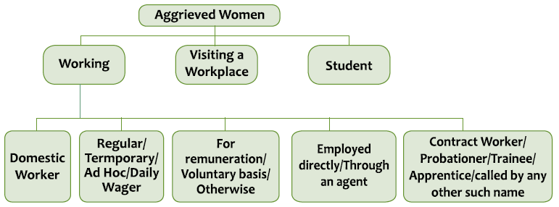

Slide 21
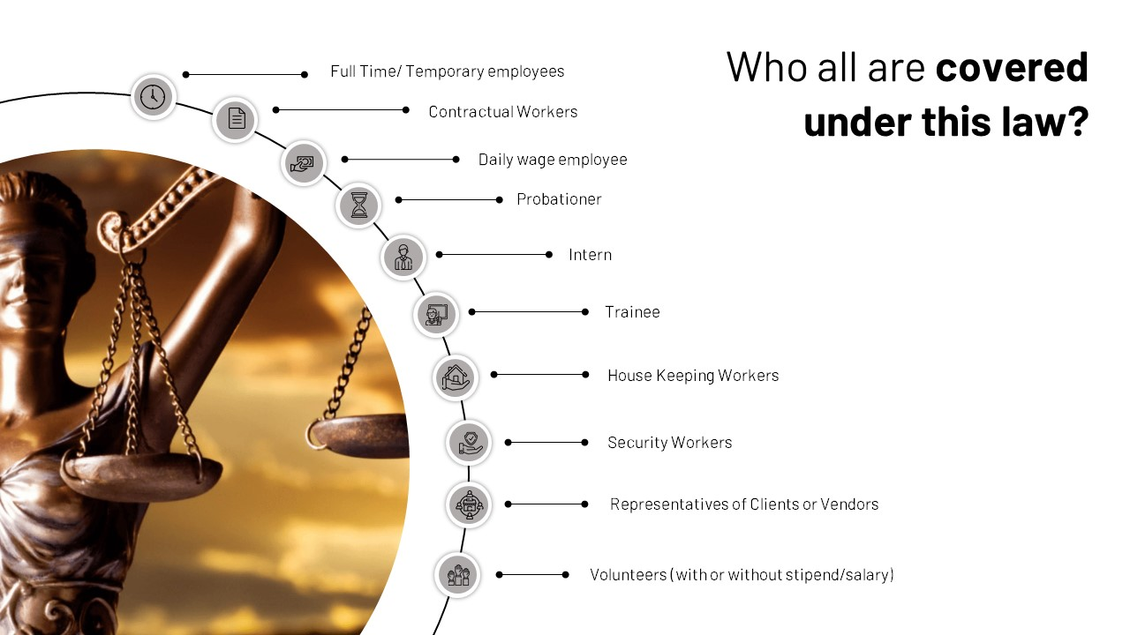

Slide 22
If you are a victim of sexual harassment, what should you do?
If you feel comfortable in approaching the harasser yourself, you could directly tell the perpetrator that you find his behaviour unwelcome or inappropriate and ask him not to repeat. Or
You can approach the Internal Complaints Committee established within your organization under Sexual Harassment of Women at Workplace (Prevention, Prohibition and Redressal) Act (the SH Act), 2013 with a written complaint. (10 or more employees) Or
In case, your organisation does not have ICC or if you want to make a complaint against the employer himself or if you work in the capacity of domestic help, then you can lodge your complaint with Local Complaints Committee established in your respective district under the SH Act. Or,
You can contact the nearest police station to lodge an FIR against the perpetrator. Both FIR with the police and complaint with Complaints Committee can be filed simultaneously.

Slide 23
What is the Internal Complaints Committee?
Every employer is required to constitute an Internal Complaints Committee (ICC) at each office or branch with 10 or more employees.
The Complaints Committees are required to provide for conciliation before initiating an inquiry if requested by the complainant.
Responsibility of Administration: The State Government will notify the District Officer in every district, who will constitute a Local Complaints Committee (LCC)
to enable women in the unorganized sector or small establishments to work in an environment free of sexual harassment.
The Ministry of Women & Child Development has launched a Sexual Harassment electronic Box (SHe-Box). It is an effort to provide a single window access to every woman

Slide 24
Composition of Internal and Local Complaints Committees (ICC & LCC)
Internal Complaints Committee
Local Complaints Committee
Chairperson – Women working at senior level in the organisation
2 Members (at least) – Amongst employees committed to women issues, have legal knowledge or experience in social work
1 Member – from NGO
Chairperson- Nominated from amongst the eminent women in the field of social work and committed to the cause of women
Member- Nominated from amongst the women working in the block, taluka or tehsil or ward or municipality in the district
2 Members- Nominated from amongst such NGO/ associations/persons committed to the cause of women or familiar with the issues relating to sexual harassment
Ex Officio member - The concerned officer dealing with social welfare or women and child development in the district

Slide 25
How to locate ICC and LCC
ICC - As per the Act, the employer is obligated to display the order constituting ICC at any conspicuous place in the workplace. However, if this is not done, then one can contact the employer/head of the department/human resource department to obtain information about the ICC constituted under the SH Act.
LCC of Particular District –
  Contact the District Officer’s office,
  Contact One Stop Centre/Women Helpline (toll free thorugh181, 100 etc.) functioning in your district/State
  Contact the State Commission for Women
  Contact the State Department of Women and Child Development/department looking after women issues

Slide 26
How to make a complaint of sexual harassment at workplace under the SH Act??
In case, aggrieved woman is unable to submit written complaint, the Complaints Committee will provide her all assistance so that the complaint could be submitted in written form.
Further, if the Complaints Committee is satisfied, it can extend the time limit for submission of complaint (not exceeding three months), however the reason for such extension will be recorded in writing.

Slide 27
What will the Complaints Committee does when a complaint is submitted to it?
Conciliation - The Internal Committee or, as the case may be, the Local Committee, may, before initiating an inquiry at the request of the aggrieved woman take steps to settle the matter between her and the respondent through conciliation
  Provided that no monetary settlement shall be made as a basis of conciliation.
Inquiry - The Complaints Committee (ICC/LCC) will conduct an inquiry into the complaint by calling all the concerned parties i.e. complainant, respondent [the person(s) against whom complaint is being made], witnesses etc. Later, on the basis of the testimonies of the concerned parties and evidences (documentary or otherwise) gathered, the Committee will frame its findings, which will be shared with the employer.
Action - If the Committee comes to the conclusion that the allegations against the respondent are genuine, it shall recommend action that needs to be taken by the employer against such person as per the service rules applicable. In absence of any service rules LCC will hand over the matter to the Police. However, if the Committee concludes after inquiry that no case is being made against the respondent,, it shall recommend that no action to be taken against the respondent.

Slide 28
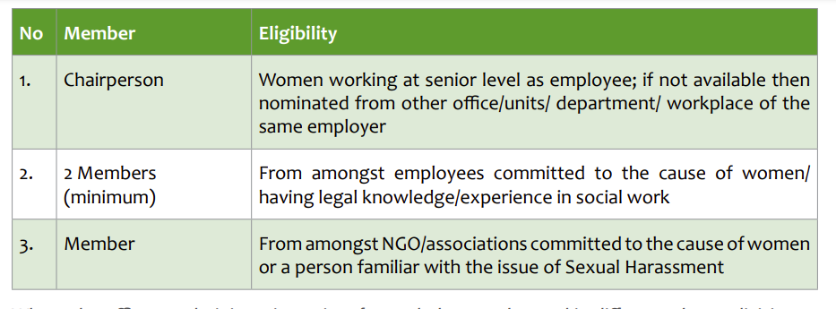
Internal Complaints Committee (ICC)

Slide 29
Who is eligible to file a complaint?
Aggrieved woman herself;
Where the Aggrieved Woman is unable to make a Complaint on account of her physical or mental incapacity , a Complaint may be filed by any prescribed person, on her behalf;
Where the Aggrieved Woman for any other reason is unable to make a Complaint, a Complaint may be filed by a person who has knowledge of the incident, with her written consent;
Where the Aggrieved Woman is dead, a Complaint may be filed by any person who has knowledge of the incident, with the written consent of her legal heir(s).

Slide 30
Can the complainant ask for some interim relief during the inquiry from ICC?
During the inquiry, at the written request of complainant, ICC can provide following interim reliefs to the complainant:
Transfer the complainant or respondent to any other place
Grant leave to the complainant for upto 3 months in addition to her entitled leave
Restrain the respondent from reporting on the work performance/ writing confidential report of aggrieved
Restrain the respondent from supervising academic activities of aggrieved

Slide 31
What kind of punishment could be awarded under the Act?
As prescribed under the Service Rules
In case service rules do not exist -
  Disciplinary action including written apology, reprimand, warning, censure
  withholding of promotion/ pay raise/ increment
  Termination of employment
  Undergo counselling Community service
Deduction from salary for:
  Mental Trauma, pain, suffering and emotional distress caused
  Medical expenses incurred
  The loss of career opportunity
  The income and financial status of respondent
If the amount is not paid it can be recovered as arrear of land revenue

Slide 32
Inquiry Time Frame
Description | Time frame
Submission of Complaint | Within 3 months of the last incident
Completion of Inquiry | Within 90 days
Submission of Report by ICC/LCC to employer/DO | Within 10 days of completion of the inquiry
Implementation of Recommendations by employer | Within 60 days
Appeal | Within 90 days of the recommendations

Slide 33
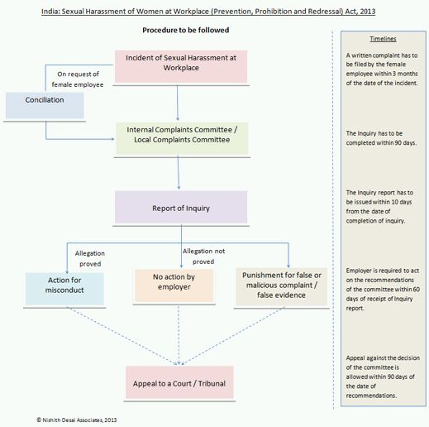

Slide 34
Confidentiality of the cases related to sexual harassment at workplace?
The Act prohibits the disclosure of:
Identity and address of complainant, respondent and witnesses
Information pertaining to conciliatory/ inquiry proceedings or recommendation of ICC or action taken by the employer.
Breach of confidentially will invite a penalty of Rs. 5,000/- which will be collected by the employer
Exception: Dissemination of information regarding the justice secured without disclosure of name, address, identity and particulars of complainant or witnesses

Slide 35
Powers of the Internal Complaints Committee
The Internal Complaints Committee plays an important role in the functioning of the provisions of the Act and to ensure the fulfilment of its objectives of the Internal Complaints Committee Policy.
Thus, the main function of the Internal Complaints Committee is:
Implementation of the Internal Complaints Committee Policy relating to the prevention of sexual harassment.
Resolving complaints by the aggrieved based on the guidelines of the Internal Complaints Committee Policy.
Recommending actions to be taken by the Employer.
As per Section 11(3) the Internal Complaints Committee enjoys the powers same as that of a Civil Court and therefore:
It is empowered to initiate an inquiry into a complaint of sexual harassment at the workplace according to the Internal Complaints Committee Policy.
IC has the power to summon witnesses and parties to state the committee.
It enjoys the discretion of summoning evidence to be examined if it may be deemed necessary to do so by the members of the Committee.

Slide 36
Punishment for false or malicious complaint and false evidence
After an inquiry in accordance with the procedure prescribed, if the malicious intent on part of the complainant is established, ICC/LCC may recommend to take action against the complainant.
But a mere inability to substantiate a complaint or provide adequate proof need not attract action against the complainant.
In case witness produces false information or documents, he/ she is also have to face the consiquences.

Slide 37
In the end…
Do to stay quiet. Tell your friends, tell your dear ones.
Make date wise notes in your diary about the incidences.
Right to Life – Article 21 – Right to life with Dignity.
Laws are to get Justice not to take revenge.
Know your importance yourself otherwise no one will recognise it.

Slide 38
Conclusion
Take Care and Stay Safe Because you are Important!

Slide 39
Thank You!
Presentation by
Ms. Khushbu Prasad
prasadkhushbu09@gmail.com
8789015803

